Slide 1



learn invent impact
Why the Atlas platform
Suresh C. Kothari
Department of Electrical and Computer Engineering
President & Founder EnSoft Corp.
Acknowledgement: Team members at Iowa State University and EnSoft, DARPA contracts FA8750-12-2-0126 & FA8750-15-2-0080

Slide 2
We need a new technology to understand manage complexity of software, it is a massively connected system

Slide 3
Software as a massively connected system
Software is in essence a graph G(S)
We need a graph database technology which we can readily answer all sorts of queries, and perform graph projections to understand, analyze, verify, and transform software S

Slide 4
Why do we use Atlas?
Manual analysis/verification of any real-world software is practically impossible without an automated tool
Compared to other automated tools, the unique and powerful capabilities of Atlas are:
Creating and reasoning with programming language agnostic mathematical abstractions of software
Visualizing relations between program artifacts and querying them through a visual interface
Processing large software with millions of lines of code
Unprecedented capability to process software as a massively connected system
Enormous savings of manual efforts

Slide 5
Mathematical abstraction and its visualization
We discussed successor relation; it is a program language agnostic mathematical abstraction. It captures the control aspect of software and enables us to deduce all execution behaviors.
2
3
Statement | Successor
2 | 3
3 | 4
4 | 5
5 | 6 or 8
6 | 8
8 | 9 or 15
9 | 10 or 12
10 | 17
12 | 17
15 | 17
17 | None
4
Execution Behaviors:
5
2,3,4,5,6,8,9,10,17
2,3,4,5,6,8,9,12,17
2,3,4,5,6,8,15,17
2,3,4,5,8,9,10,17
2,3,4,5,8,9,12,17
2,3,4,5,6,8,15,17
6
8
9
15
Successor Relation = { (2 3), (3 4), (4 5), (5 6), (5 8), (6 8), (8 9), (8 15), (9 10), (9 12), (10 17), (12 17),
(15 17) }
10
12
17

Slide 6
Successor: language agnostic abstraction
Parsing
Successor algorithm
Graph layout algorithm
Graph traversal algorithm
Program
Successor Relation
CFG
Execution Behaviors
Parsing: the only language dependent step

Slide 7
Automation in Atlas: Universal Graph
Atlas stores the program semantics + precomputed relations between program artifacts, in a searchable language agnostic entity called the universal graph
Why universal graph?
Enormous savings of manual effort: User can readily obtain program artifacts and relations between them using the Atlas query language. Example: get the successor relation
Use of graph theory and algebra: User can readily perform analysis using graph algorithms. Example: Apply a graph traversal algorithm to get all the execution behaviors

Slide 8
Successor relation with Atlas
Program
Mapping/Indexing
Atlas Visualization
Graph traversal using Atlas eDSL
Atlas query
Successor Relation
Execution Behaviors
Universal Graph
CFG
In Atlas terminology
Mapping/Indexing
Parsing + Computing several program artifacts and relations between them to create the universal graph.
=

Slide 9
Time to map software in Atlas
MacBook Pro with 32 GB memory
Software | Nodes | Edges | Build Time
LINUX Small Build | 7,493,303 | 23,264,592 | 15 min
LINUX Large Build | 117,381,443 | 362,539,717 | 250 min
XINU | 28,778 | 85,729 | 30 seconds
Small: defconfig, Large: allmodconfig

Slide 10
Atlas Demo -1
Use Atlas to create the universal graph for the DBZ program
Use the queries:
get the node x for a function
y = cfg(x) \* compute the successor relation *\
show(y) \* visualize the successor relation *\
Repeat the exercise for the XINU software – about 10,000 lines of code with more than 200 functions

Slide 11
Atlas Demo -2
Visualize relations between program artifacts and query them through a visual interface (using XINU)
Get the CFG by clicking the name of a function
Get successors/predecessors of a program statement by clicking on the corresponding node in the CFG
Observe the correspondence between program statements and the nodes in the CFG

Slide 12
The last ten years of the development of Atlas
APAC
Automated Program Analysis for Cybersecurity
STAC
Space/Time Analysis for Cybersecurity
On APAC and STAC programs, our Iowa State University and EnSoft team became top performer on more than 200 software analysis challenges to detect malware. We competed with Stanford, MIT, and major research organizations in industry. Atlas was crucial for our success.
Atlas was advanced through research funded by DARPA. Tools developed using Atlas are now used worldwide in industry including all major avionics and automobile companies.

Slide 13
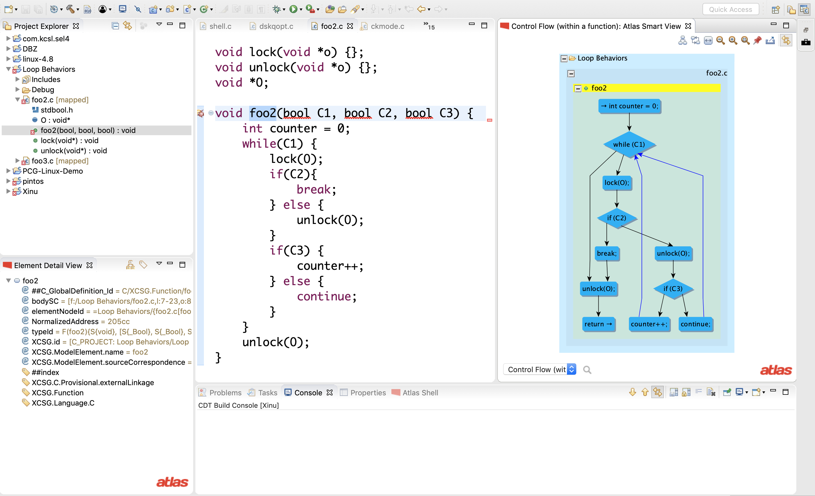
Click to open the source code
The source code window
SmartView window
Select the model type

Slide 14
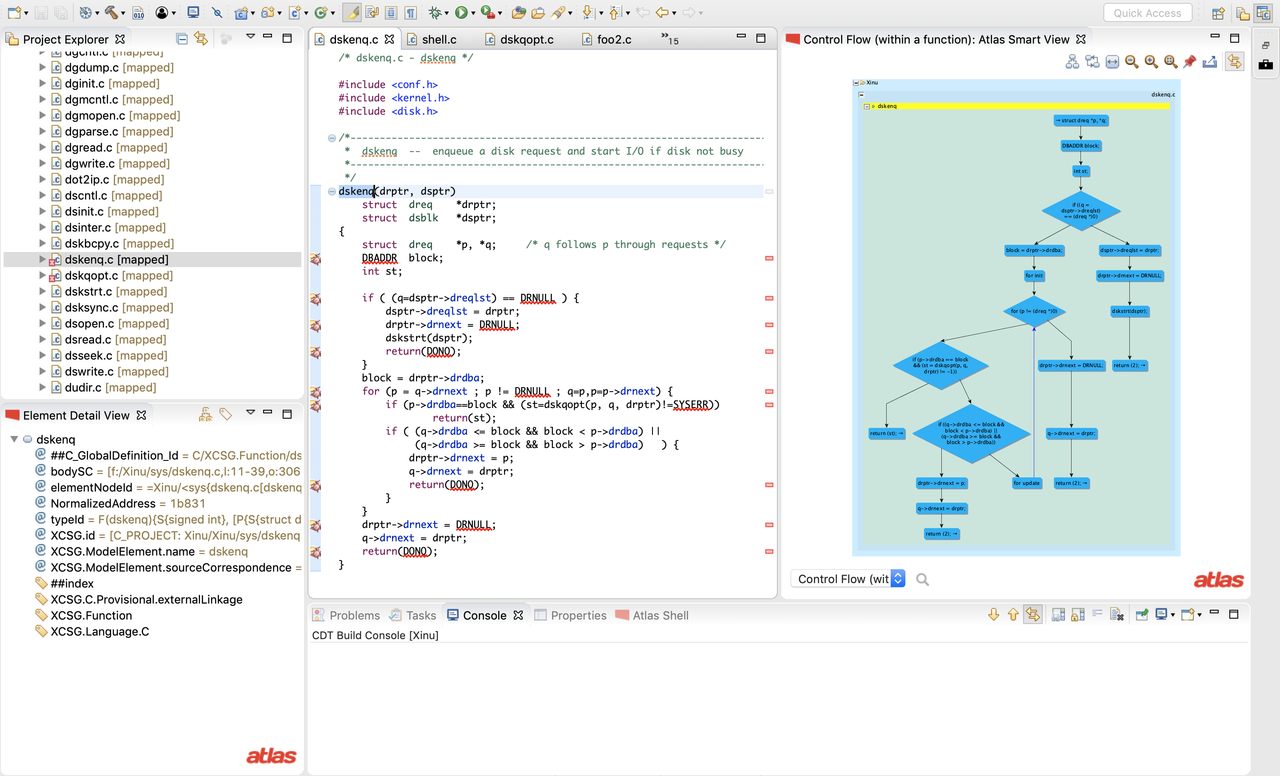
Click on dskenq
dskenq source code
CFG of dskenq

Slide 15
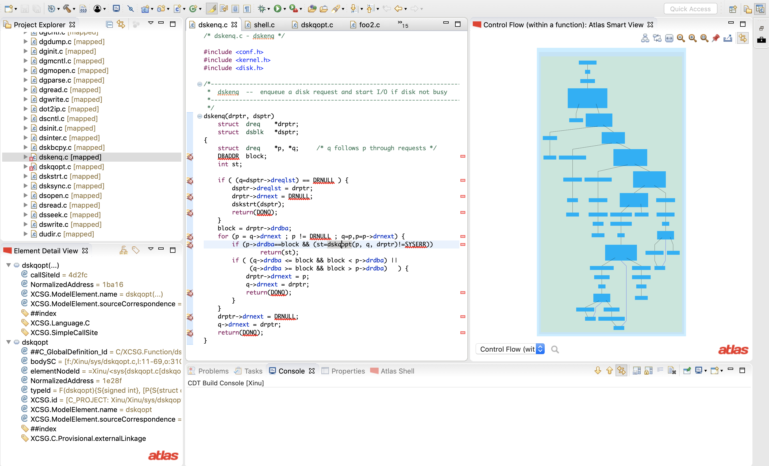
Click on dskqopt
dskenq source code
CFG of dskqopt

Slide 16
Applying a chain of SmartViews
We can use a chain SmartViews, pin one SmartView and click on a node to apply another Smart view
The next few slides show the chaining of SmartView.
The call SmartView is selected– the model shows the functions that call dskenq and the functions that are called by dskenq
The call model is pinned and the CFG model is selected for the SmartView
Each node of the call model is function, clicking on the node produces the CFG of that function in the SmartView window

